Slide 1
Design Thinking
Warm Up Question: What are your favorite Applications? Do they rely on servers or the internet? Do they make assumptions about their audience? (snapchat for example)

Slide 2
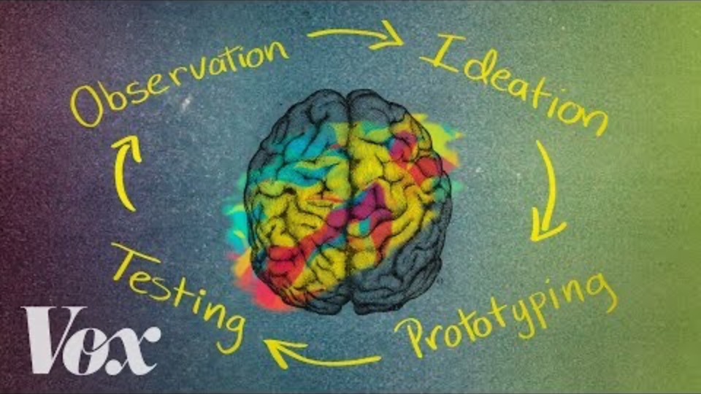
Design Thinking

Slide 3
Design Thinking
Observe
Emphasize with your audience
Gather ideas
Ideation
Assemble ideas into requirements
Prototype
Write some code
Test
Test the code you write, both internal and external
Repeat
Back to your application ideas from two weeks ago – You were Observing!

Slide 4
Observe -> Ideation (Discussion)
Have you continued to obverse the world around you?
Any new application ideas?
Discussion Time
What have you seen
What other ideas have you come up with?
Did you fall out of the habit?
Ideation
Take your observation down, and start listing actual requirements
What if you handed the requirements to someone else?
Can they prototype for you?
If not, fill them out more
Have you considered different groups that may be affected?
You do not have to dream up the next best application
But this mental game helps train the creative side of your brain!

Slide 5
Coding Practice – Loops and Strings

Slide 6
Let’s Practice
Individually
Write a method on paper
returns a String
takes in three parameters, String str, and int start and int end
In the method,
write a loop that goes from start and < end
it grabs the charAt that index, and adds it to a string (hint, start with an empty string)
returns the new string you built!
After five minutes, we will have you pair up, and work together on the method
Question
What method did you just build?
Does it seem familiar?
Overload the method
takes in two parameters, String str, and int start
Assumes end is the str.length()

Slide 7
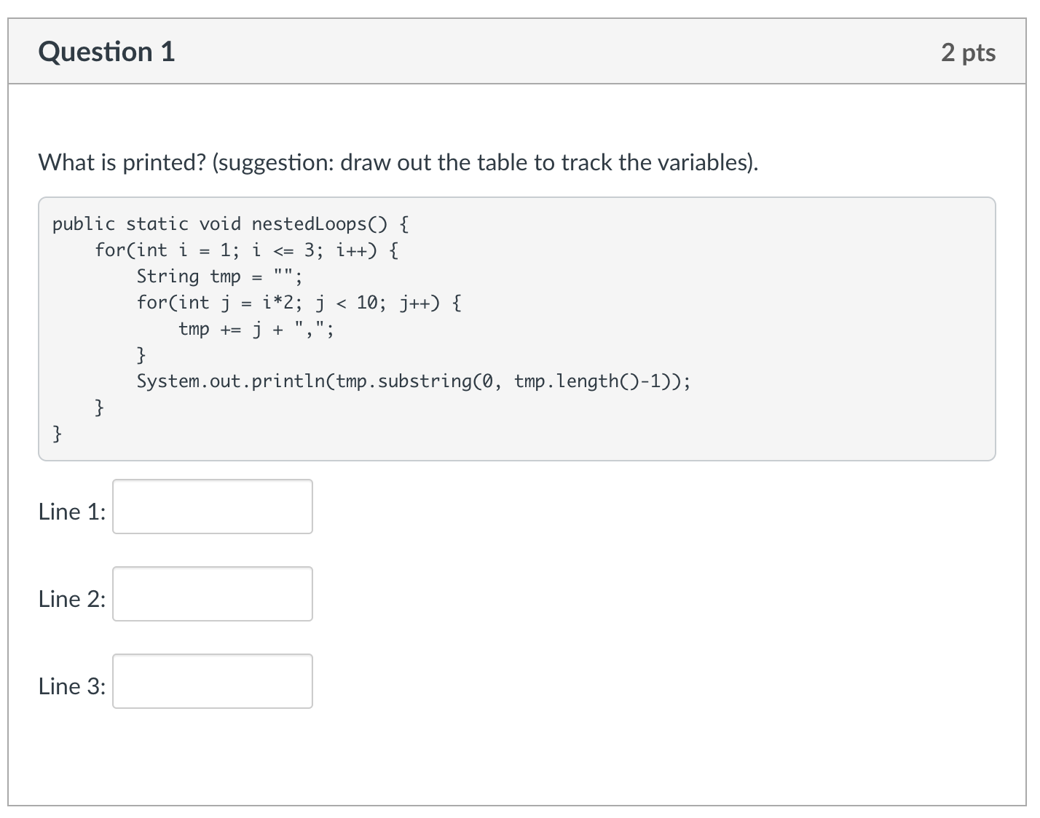
Knowledge Check

Slide 8
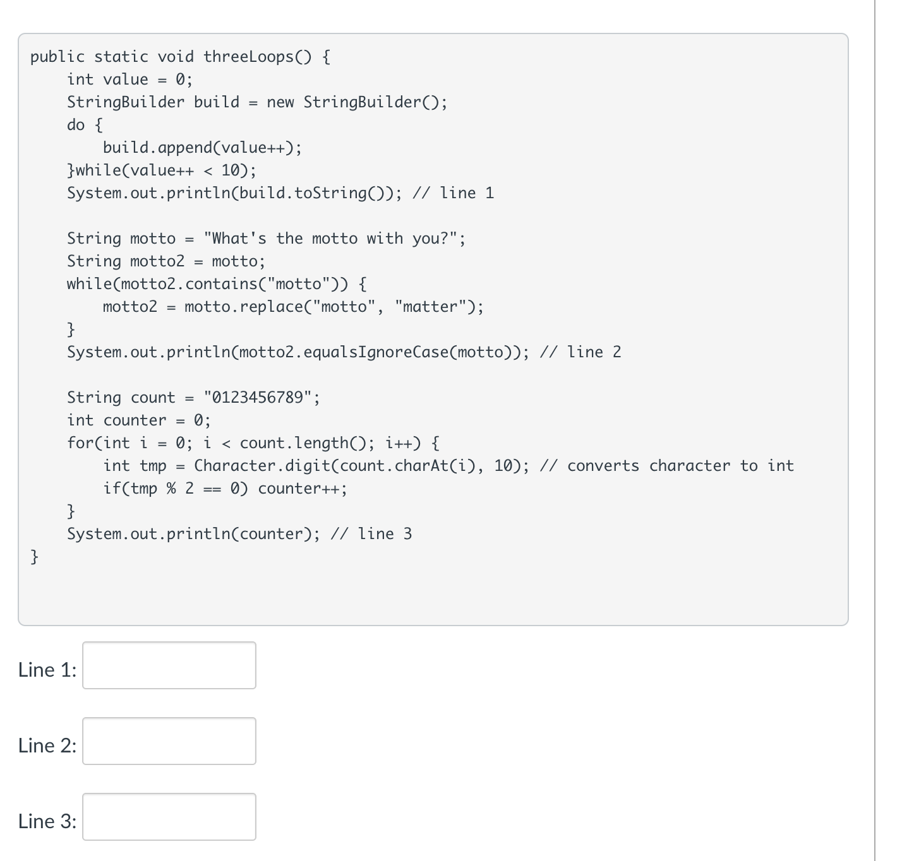
Knowledge Check
A lot is going on in this one!
Talk it through with others
The TA will guide you!
essentially 3 questions in one

Slide 9
More practice
Let’s go to code
methods
loops
indexOf
charAt
Remember hangman or crossword puzzles that we played the second week!!!
Hangman or crosswords
we indexed the words starting at 0

